Slide 1
Bridget analysis
May 28, 2020

Slide 2
Nomenclature
Variable name | Outcome
asas40 | ASAS 40%
major | ASDAS Major Improvement
cii | ASDAS Clinically Important Improvement

Slide 3
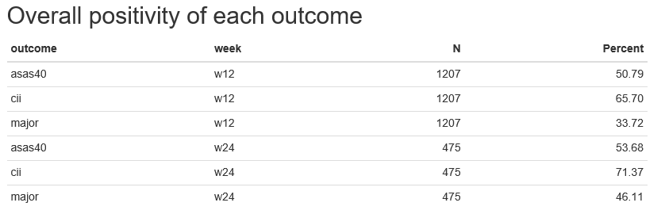

Slide 4
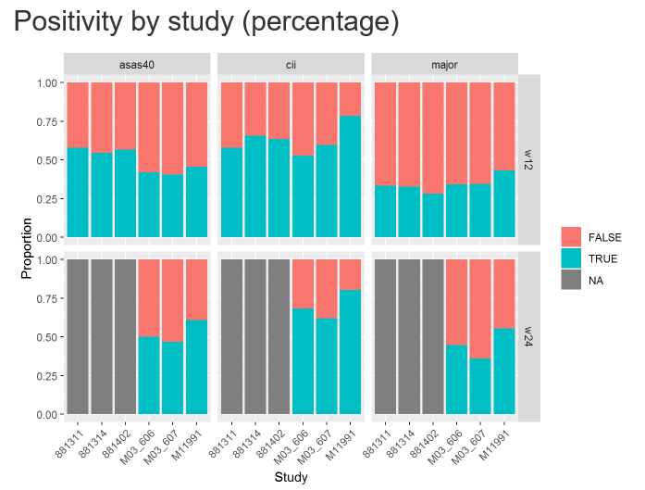

Slide 5
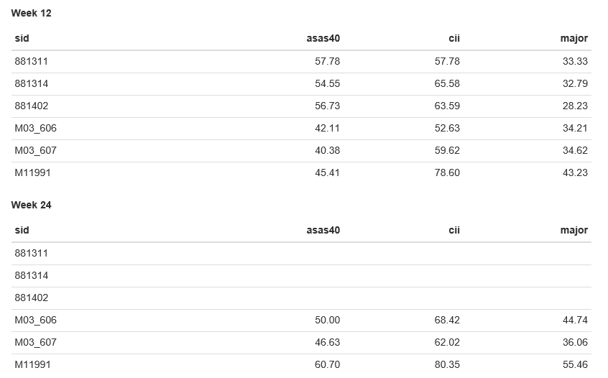
Percent positive outcomes by week

Slide 6
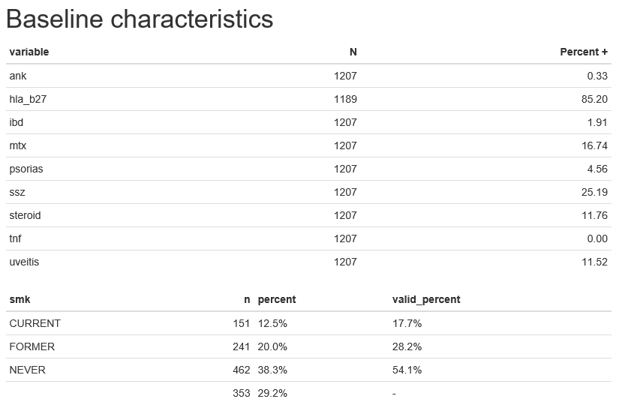

Slide 7
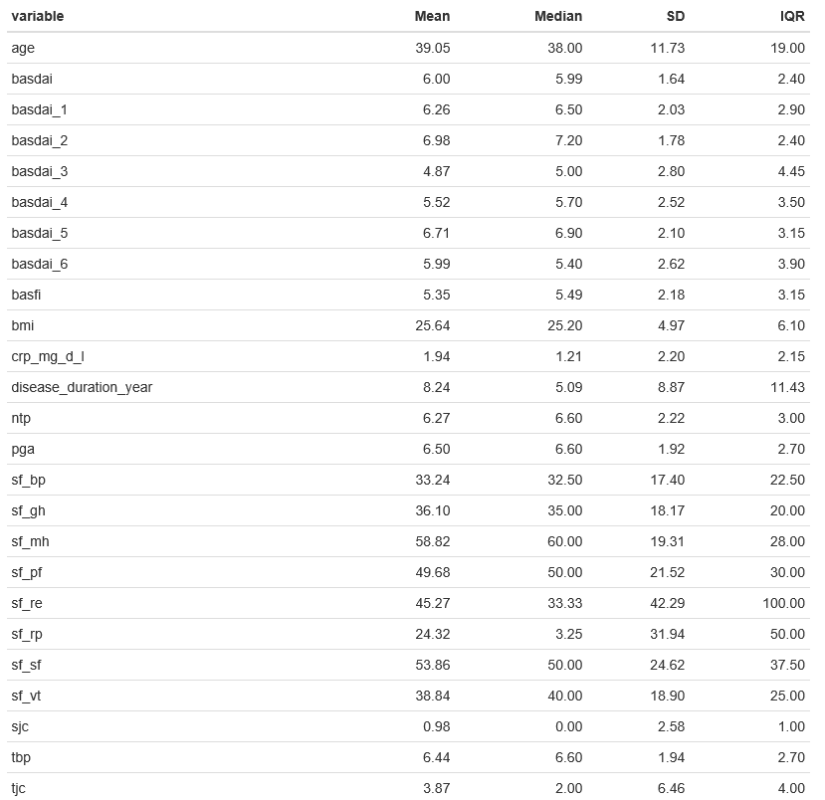

Slide 8
Comparing studies

Slide 9
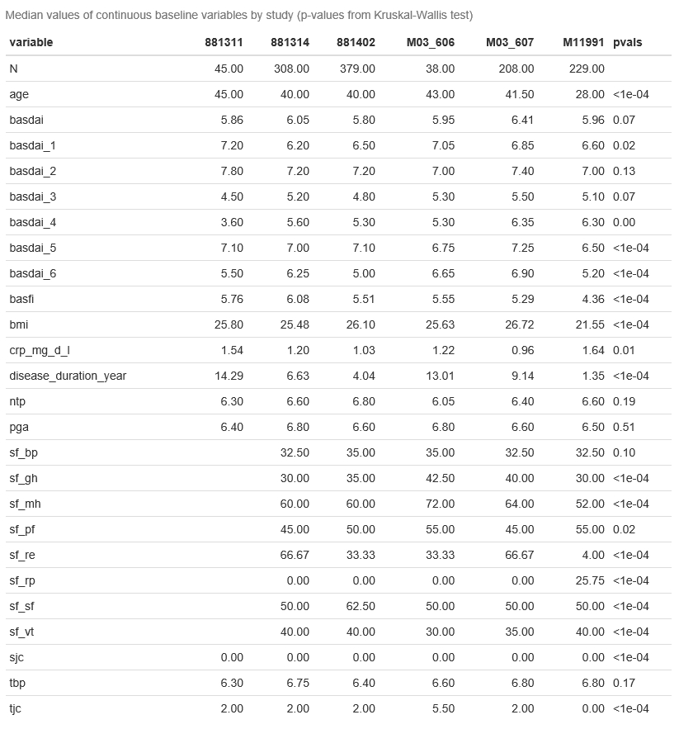

Slide 10
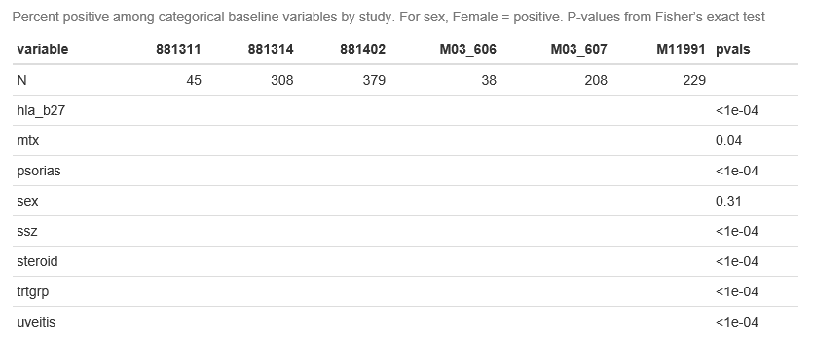

Slide 11
Discriminatory power of baseline variables

Slide 12
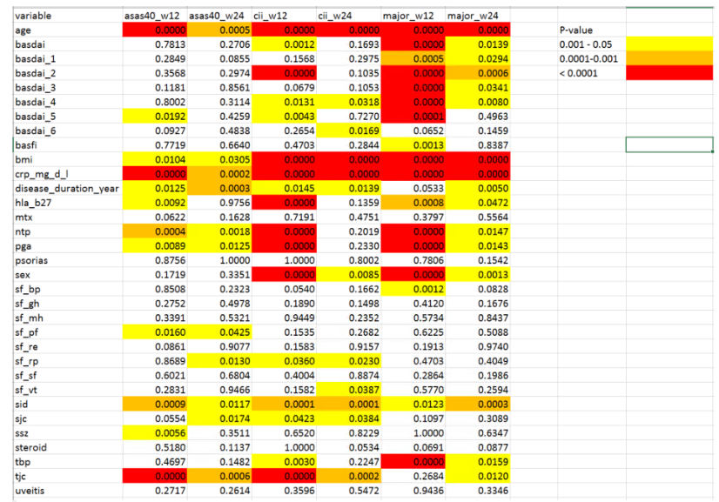
We have 33 variables
With Bonferroni correction,
p-values < 0.0001 corresponds
to a FWER of < 0.033

Slide 13
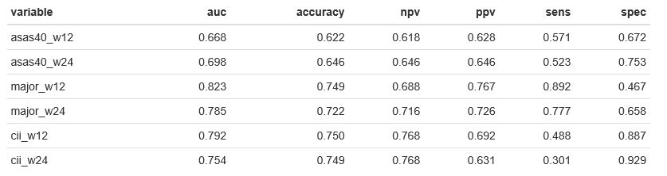
Logistic regression models

Slide 14
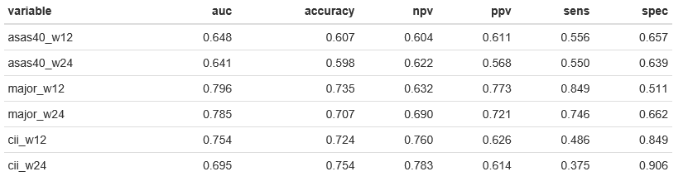
Random forests, for comparison

Slide 15
Continuing with logistic models
Easier to interpret
Beating random forest in performance
Can compute nomograms (predictive scoring)
  Draws a partial nomogram that can be used to manually obtain predicted values from a regression model that was fitted with rms. The nomogram does not have lines representing sums, but it has a reference line for reading scoring points (default range 0–100). Once the reader manually totals the points, the predicted values can be read at the bottom.

Slide 16
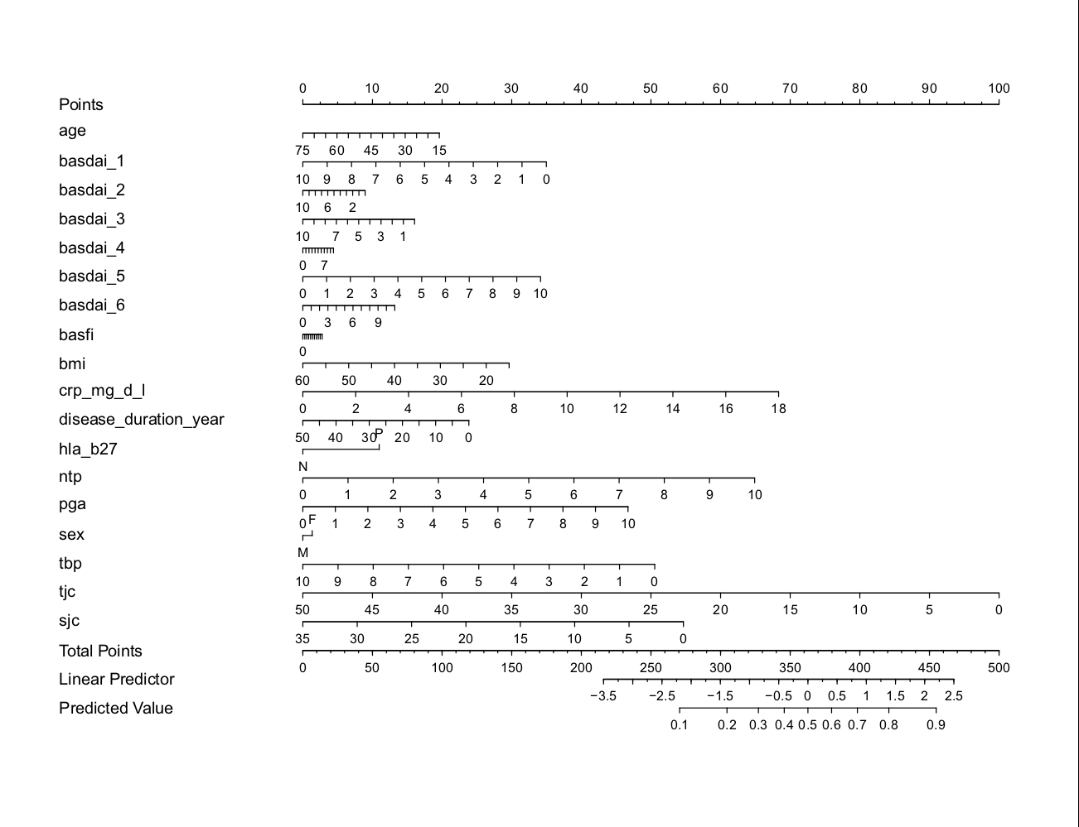
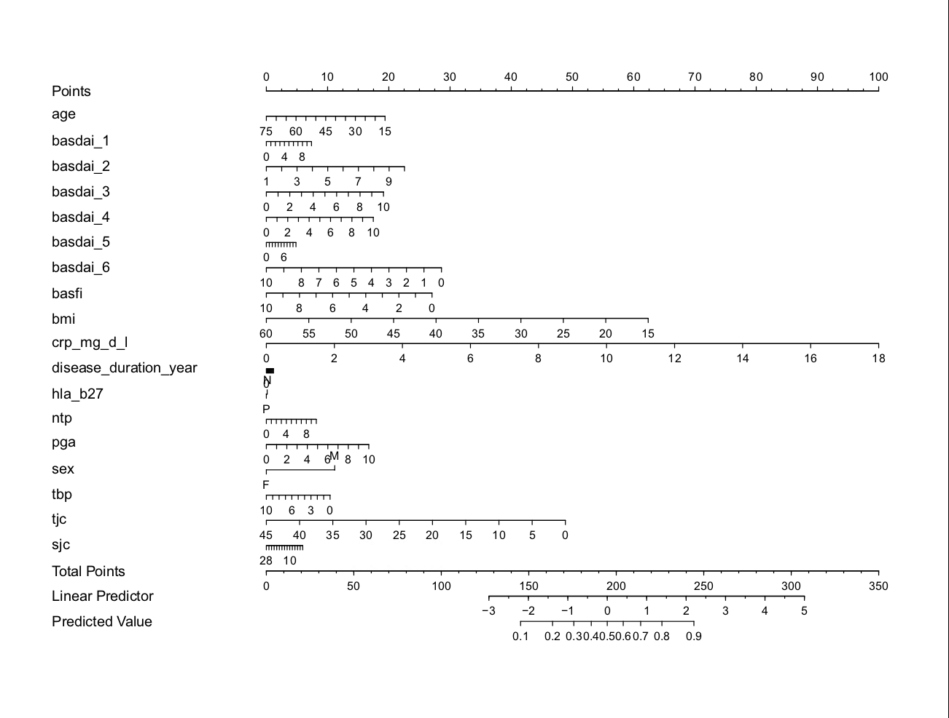
Asas40_w12

Slide 17
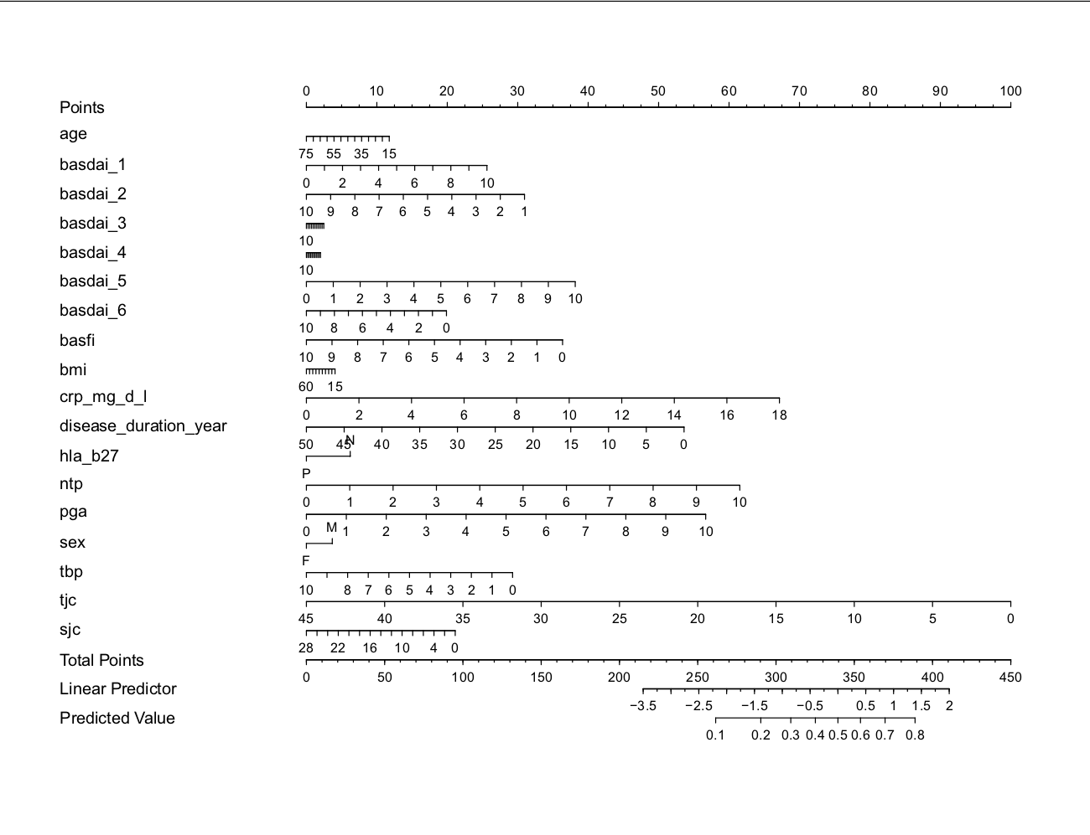
Asas40_w24

Slide 18
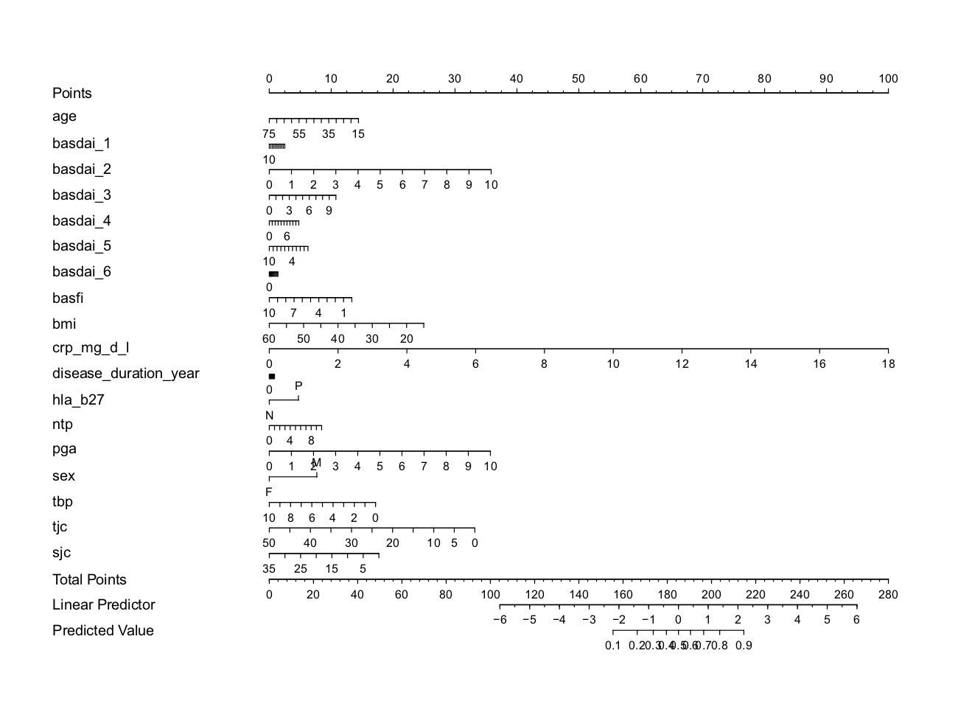
Major_w12

Slide 19
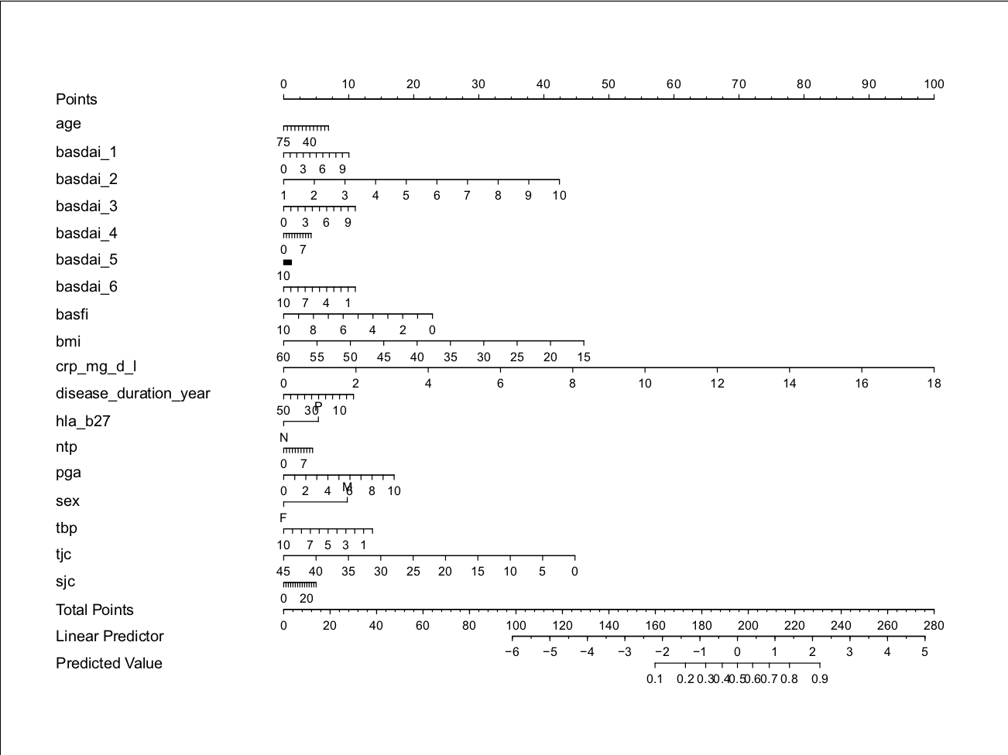
Major_w24

Slide 20
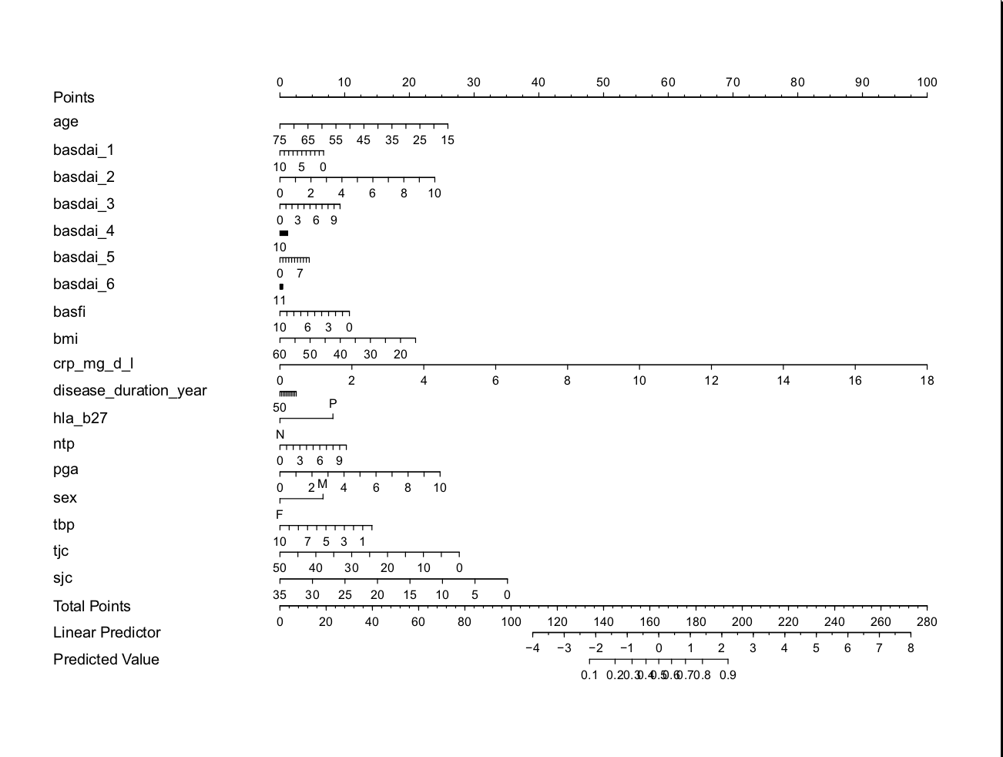
Cii_w12

Slide 21
Cii_w24

